Slide 1



By: GradNav team
Mostafa Nashat
Mostafa Osman
Mohamed Sabri

Slide 2



Overview
Introduction
01
Our Mision
02
Our Services
03
Strategy
04
Experience
05
Project Timeline
06
Strategy
07
Our Team
08

Slide 3

Introduction
GradNav platform empowers fresh graduates with career-focused courses and hands-on interview simulations
Our Mission
We bridge the gap between education and employment, ensuring a smooth transition into the job market

Slide 4



Problem statement
The Challenge for Fresh Graduates
Lack of industry-ready skills
Limited real-world interview experience
Difficulty in standing out in a competitive job market

Slide 5

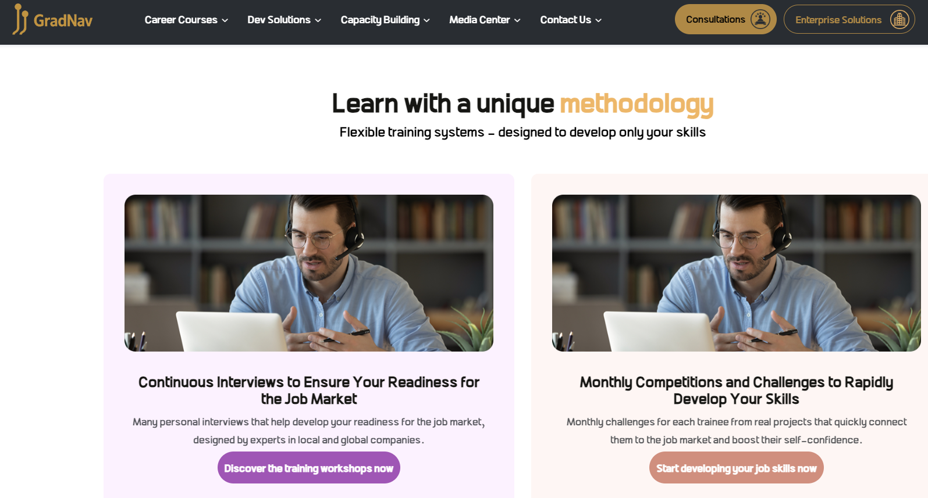
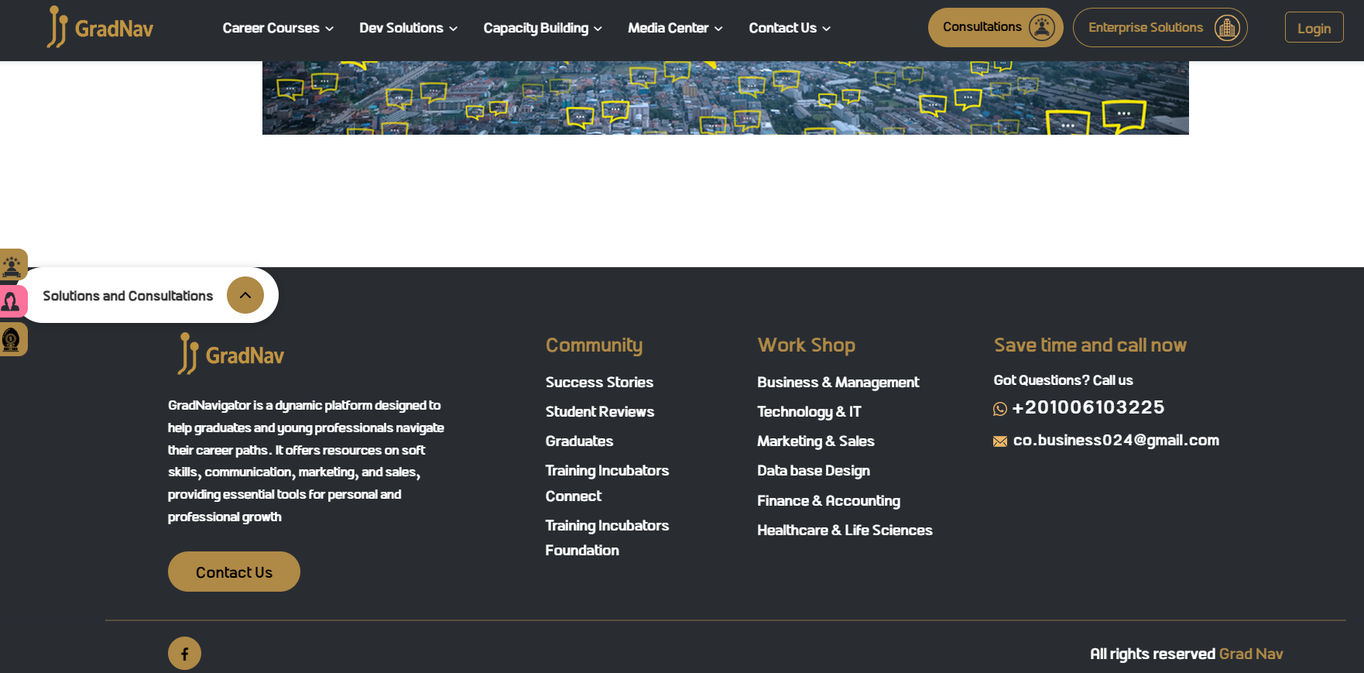
Our Solution
GradNav – Bridging the Gap
Career-based courses tailored to market needs
AI-driven and mentor-led interview simulations
Personalized career guidance & resources

Slide 6

01
Interactive Courses – Industry-specific skills training
Key Features
02
  Live Interview Simulations – AI & expert feedback
What We Offer ?
03
  Personalized Learning Paths – Data-driven recommendations
04
  Community Support – Networking & mentorship

Slide 7



User Benefits
Why GradNav platform?
Build confidence with interview practice
Get career insights from experts
Increase chances of landing a dream job
Gain job-ready skills
1
2
3
4

Slide 8
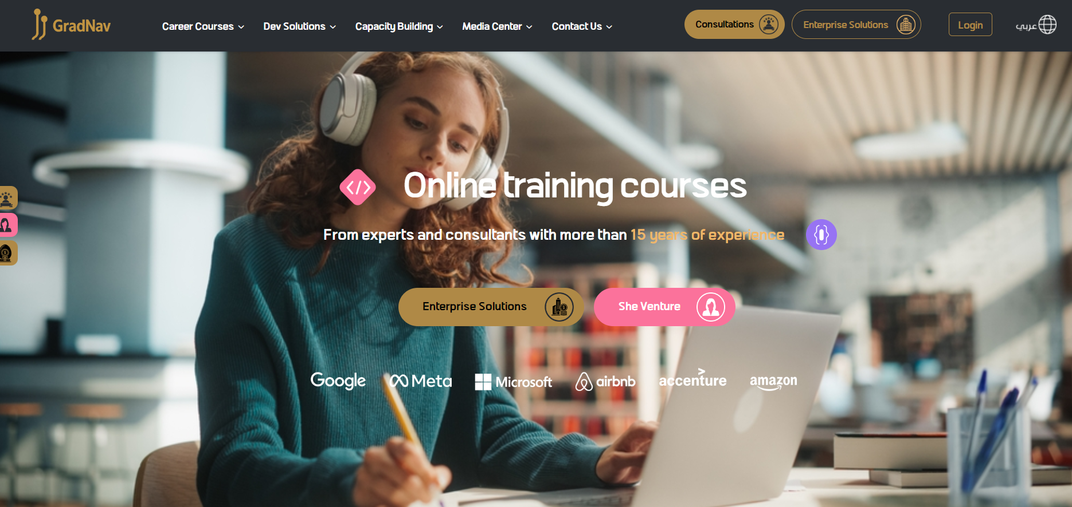

Slide 9

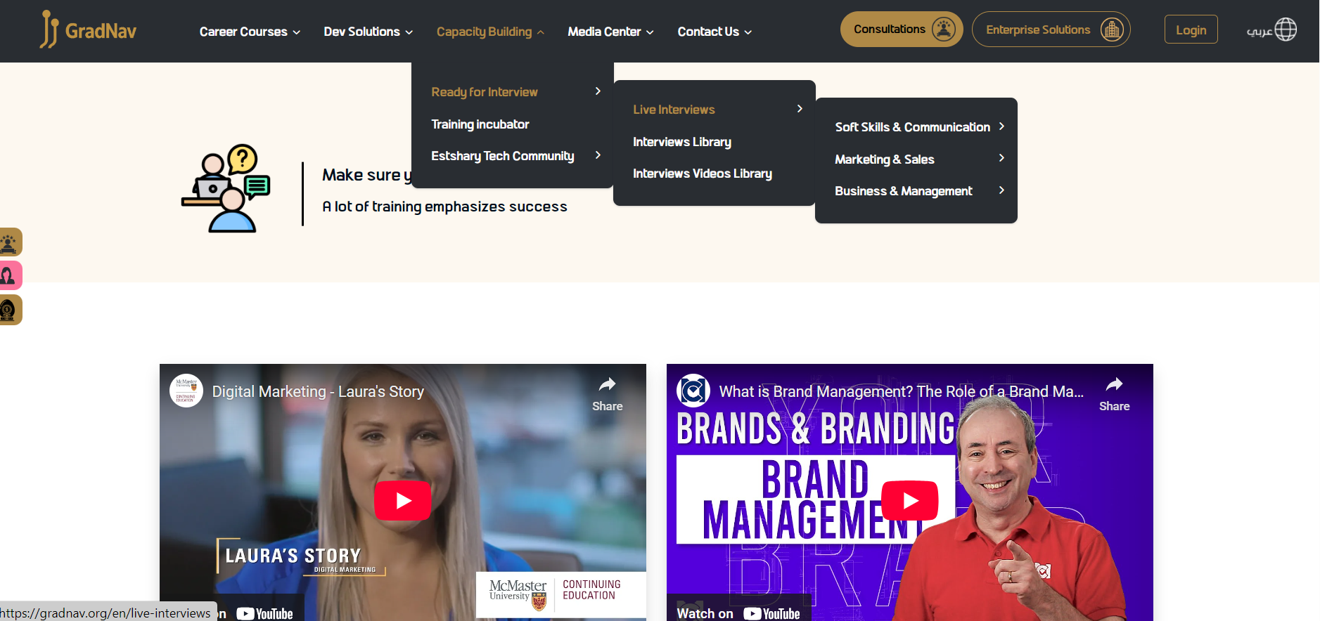
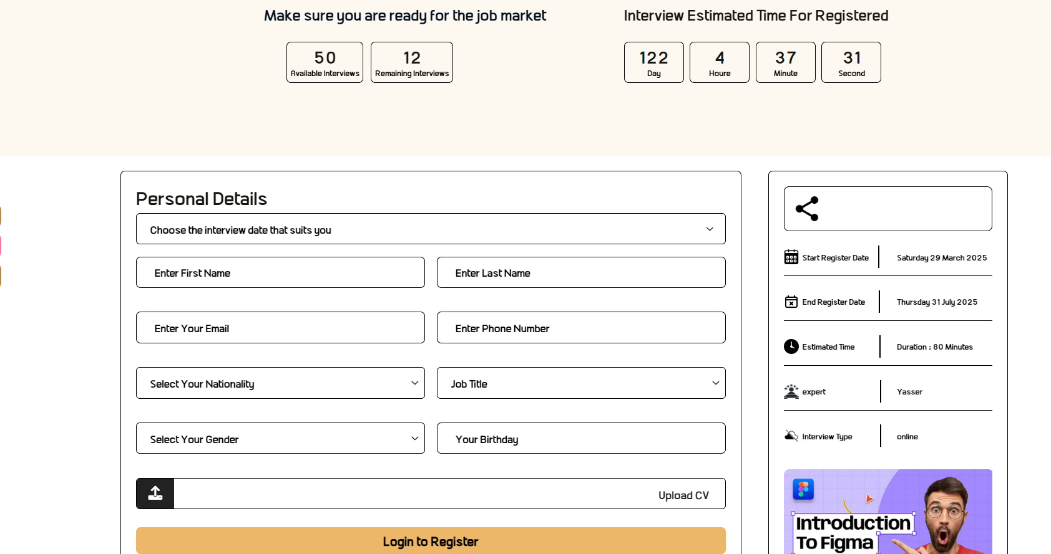




How It Works
Simple & Effective
Take personalized courses
Practice interviews & get feedback
Apply for jobs with confidence
Sign up & set career goals
1
2
3
4

Slide 10




Market Opportunity
Growing Demand for Job-Readiness Platforms
Fact
Approach
Way Out
52% of graduates struggle with employment (cite data)
Rising demand for online career coaching
AI-driven learning is the future of career training

Slide 11

Market Opportunity
Growing Demand for Job-Readiness Platforms
Problem 01
Problem 02
Problem 03
80% of employers prefer candidates with practical experience
60% of graduates struggle to transition from education to employment
Online career coaching and AI-driven hiring tools are on the rise

Slide 12

GradNav Project Timeline (2025)
📌 Stage 1: Development (Jan – April 2025)
Jan – Feb: Market research, competitor analysis, and business planning
March – April: Website development & branding (GradNav website launch)
📌 Stage 2: Beta Testing & Platform Expansion (April – Aug 2025)
April – June: Develop core platform features (AI interviews, career courses, user dashboards)
July: Beta testing with early users (universities & fresh graduates)
Aug: Refinements based on user feedback, marketing & partnerships
📌 Stage 3: Mobile App Launch & Growth (Aug – Dec 2025)
Aug-Oct : Final mobile app development, integration & testing
Nov- Dec: Official GradNav Mobile App Launch + marketing campaign
Post-Launch: Scale operations, onboarding partnerships, and continuous feature updates

Slide 13





Monetization Strategy
Sustainable & Scalable Model
Subscription Plans – Access premium courses & tools
One-time Fees – Pay for expert-led interview sessions
Corporate Partnerships – Connect companies with top talent.
Freemium Model – Basic access for free, premium upgrades available

Slide 14


TAKE THE NEXT STEP
Your career journey begins today!
Sign up at GradNav.org and connect with us to shape future professionals.

Slide 15


CONCLUSION
GradNav platform equips fresh graduates with essential skills, practical experience, and valuable mentorship to navigate the job market successfully. By leveraging AI technology and expert guidance, we are dedicated to enhancing job readiness and boosting confidence, ensuring that graduates can stand out in their career pursuits.

Slide 16
THANK YOU!

